Slide 1


Slide 2

Overview
Among so many types of devices that are essential during the concerning hours of pandemic, the necessity of pulse oximeter can never be denied. As per information fetched and verified, the virus named SARS-COV-2 is highly infectious and causes critical respiratory illness. This is also one of the major reasons why each of us should stay aware of the importance of the pulse oximeter.
The non-invasive device named pulse oximeter is mainly used to measure the oxygen levels in the blood. Once we enter our fingertip into a specific section of this device, it automatically shows the numerical value of our pulse rate and SpO2. Now, it is necessary to know how it can be helpful during the concerning hours of pandemic. First of all, if it shows you a lower oxygen saturation, then it indicates that you may have any respiratory disease like COPD or Covid-19. Noticeably, Covid patients generally get a gradual oxygen-level drop and this is exactly how we can determine the presence of Covid-19 in our body through this device. As mentioned before, it can also help one know about any existing respiratory disease, which may turn deadly at the final stage. It is not hard to guess that these are the reasons why the use of pulse oximeter are hugely increasing day by day.

Slide 3
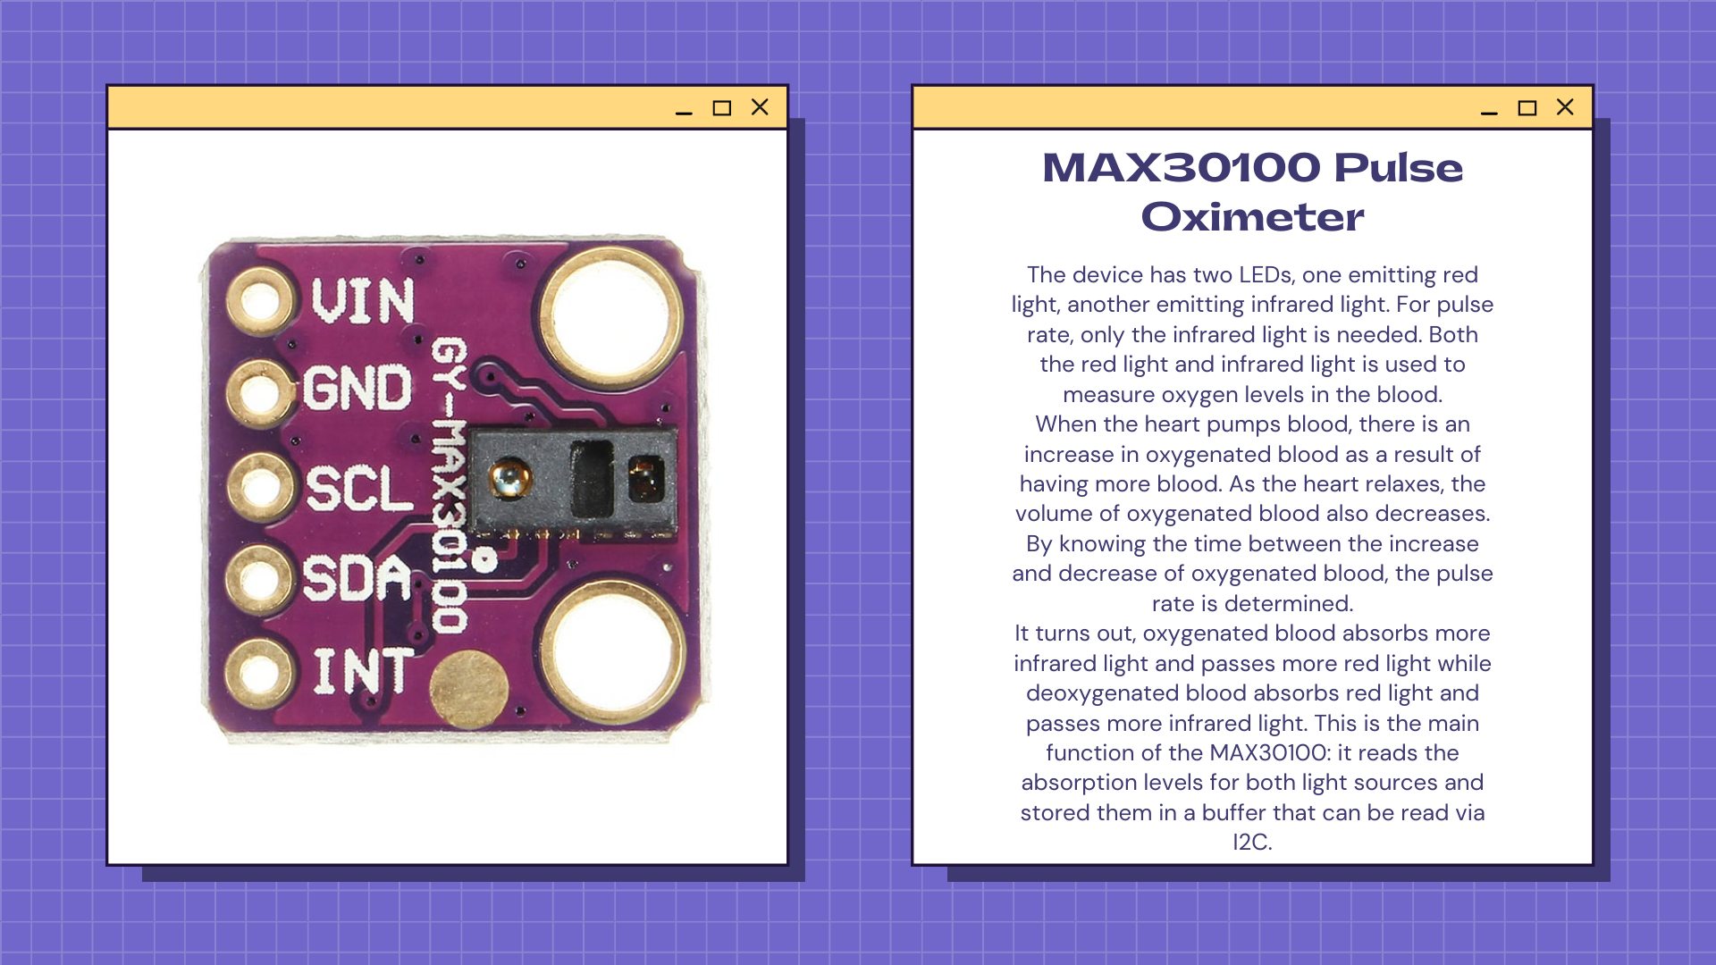

Slide 4
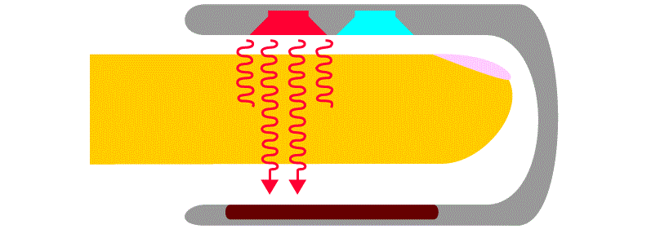
Working Principle
Pulse Oximeter uses the principal of spectrophotometry. We check the relative amount of two wavelengths absorbed by our blood arteries. This device uses two types of light i.e., Red light (660nm) and Infrared ray (940nm).
Our blood contains two type of hemoglobin: Oxygenated Hemoglobin-Hemoglobin which gets linked with oxygen. This type of hemoglobin absorbs more of infrared light as compared to red light. Deoxygenated Hemoglobin: - This is just opposite of the Oxygenatedhemoglobin; this is the hemoglobin which does not link with oxygen. It absorbs more of red light as compared to infrared light.
This device uses two types of wavelengthsto measure the oxygen amount in our blood and blood pressure. There are two ways to get the information by using two type of wavelength which are: • Transmission method • Reflectance method
Transmission method:
In transmission method, Light Emitting Diode and the light detector are present on different sides which are placed on probe. It is used to emit both the lights and make the light pass through our blood arteries. Some amount of the light gets absorbed and it decreases the intensity of light and remaining intensity of light gets detected by the detector and with the help of this data we get to know about our blood pressure and Saturation value of Oxygen in our blood (SpO2).
Reflectance Method:
In Reflectance Method, Light Emitting Diode and detector are present on the same side of the probe. It emits both the lights and some of the light passes through the arteries and remaining light gets reflected from the arteries and then the reflected light reaches the detector and with the help of that data we can conclude the blood pressure and Saturation value of Oxygen in our blood (SpO2).

Slide 5
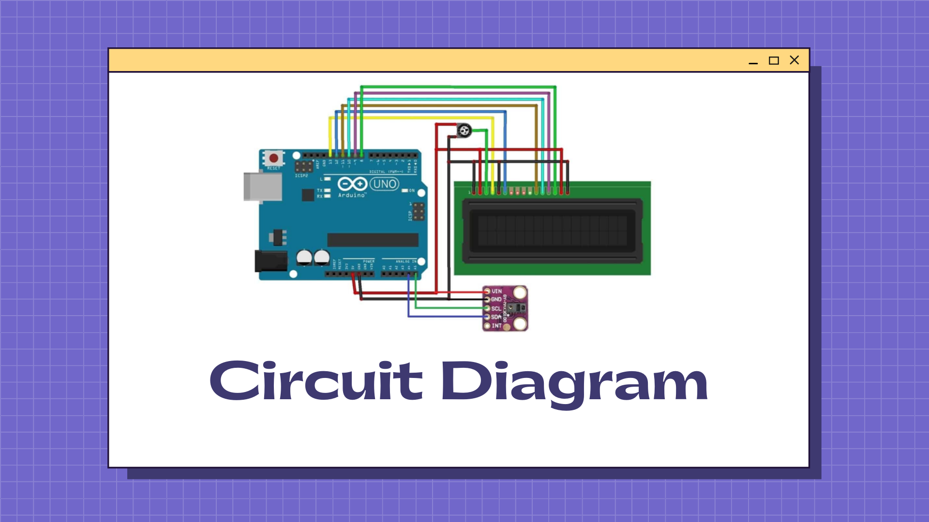

Slide 6
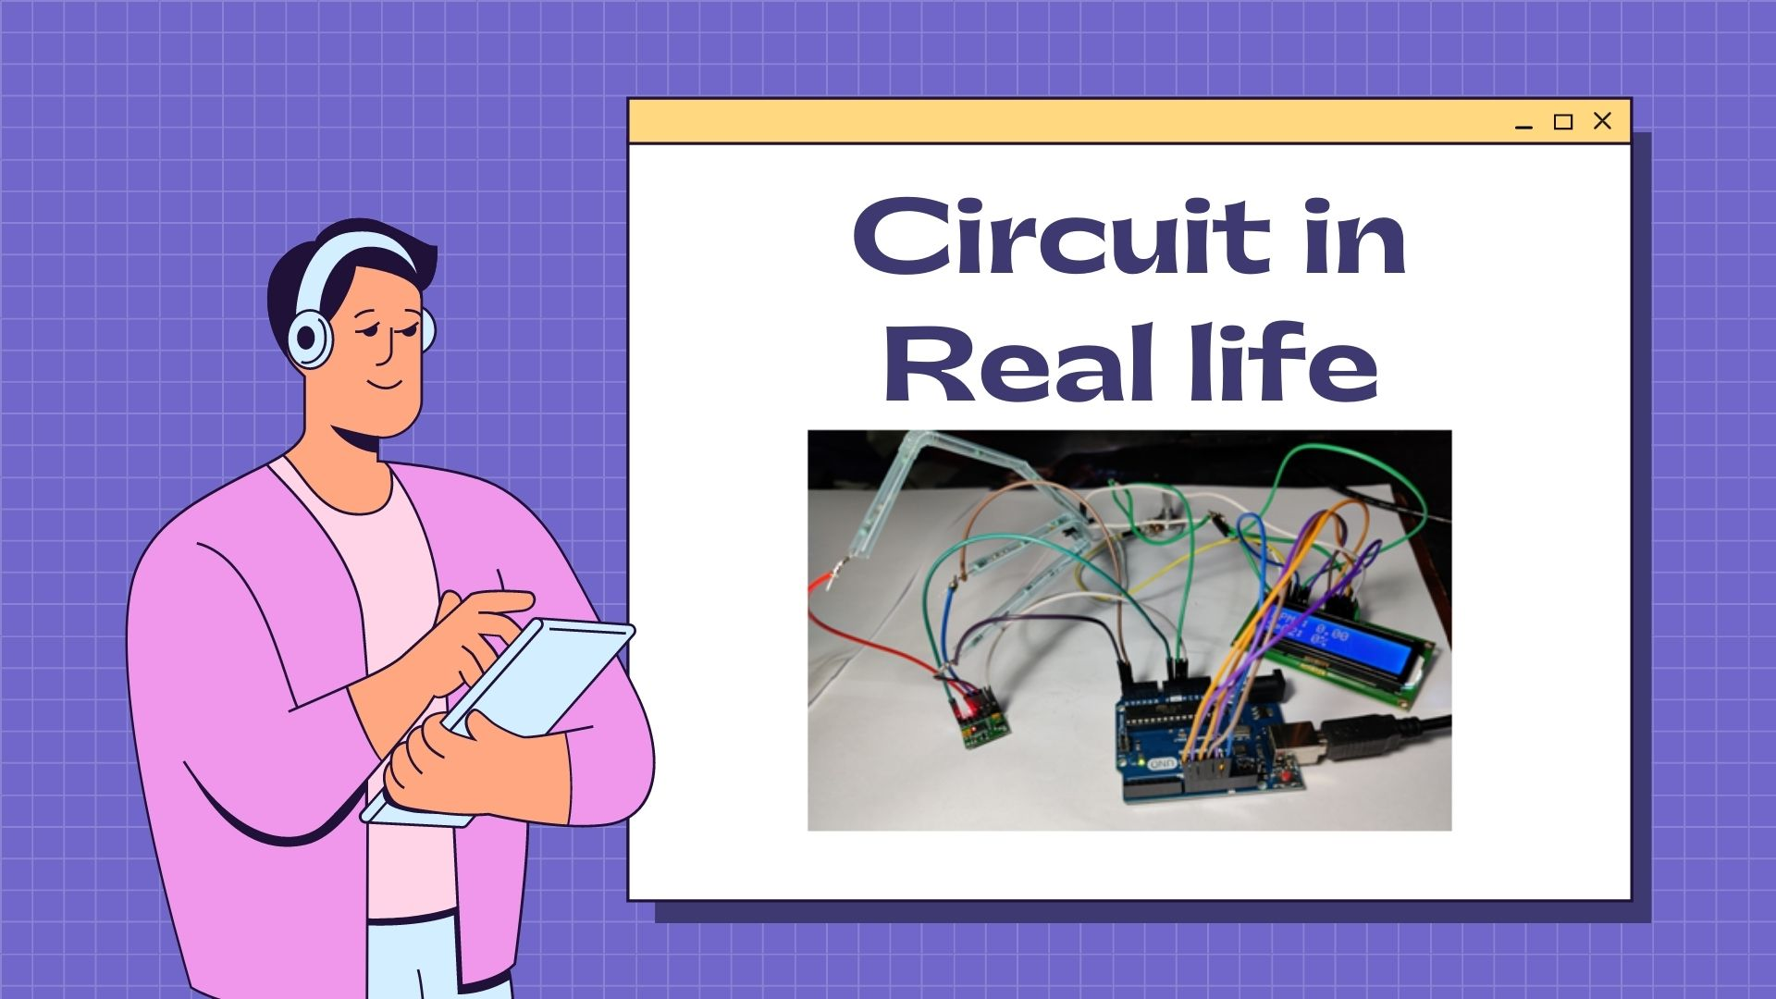

Slide 7
//code begins
#include <LiquidCrystal.h>
#include <Wire.h>
#include "MAX30100_PulseOximeter.h"
LiquidCrystal lcd(13,12,11,10,9,8);
#define REPORTING_PERIOD_MS 1000
PulseOximeter pox;
uint32_t tsLastReport= 0;
void onBeatDetected()
{
Serial.println("Beat!");
}
void setup()
{
Serial.begin(115200);
Serial.print("Initializing pulse oximeter..");
lcd.begin(16,2);
lcd.setCursor(0,0);
// this complete page contains the commands related to user interface
{
lcd.println("WELCOME USER");
delay(1000);
lcd.setCursor(0,1);
lcd.print("PULSE OXIMETER");
delay(2000);
lcd.clear();
lcd.setCursor(0,0);
lcd.print("MEMBERS");
delay(2000);
lcd.clear();
lcd.setCursor(0,0);
lcd.println("AYASHKANTA MISHRA");
lcd.setCursor(0,1);
lcd.print("20ME10027");
delay(3500);
lcd.clear();
lcd.setCursor(0,0);
lcd.println("CHAITANYA GAUR");
lcd.setCursor(0,1);
lcd.print("20MA20017");
delay(3500);
lcd.clear();
lcd.setCursor(0,0);
lcd.println("ADITYA PAL");
lcd.setCursor(0,1);
lcd.print("20BT10004");
delay(3500);
lcd.clear();
lcd.setCursor(0,0);
lcd.println("BURRA NITHISH");
lcd.setCursor(0,1);
lcd.print("20CS10018");
delay(3500);
lcd.clear();
}
lcd.print("Initializing...");
delay(3000);
lcd.clear();
if (!pox.begin()) {
Serial.println("FAILED");
for(;;);
} else {
Serial.println("SUCCESS");
}
pox.setIRLedCurrent(MAX30100_LED_CURR_7_6MA);
// Register a callback for the beat detection
pox.setOnBeatDetectedCallback(onBeatDetected);
}
void loop()
{
// Make sure to call update as fast as possible
pox.update();
if (millis()-tsLastReport > REPORTING_PERIOD_MS) {
Serial.print("Heart rate:");
Serial.print(pox.getHeartRate());
Serial.print("bpm / SpO2:");
Serial.print(pox.getSpO2());
Serial.println("%");
lcd.clear();
lcd.setCursor(0,0);
lcd.print("BPM : ");
lcd.print(pox.getHeartRate());
lcd.setCursor(0,1);
lcd.print("SpO2: ");
lcd.print(pox.getSpO2());
lcd.print("%");
tsLastReport = millis();
}
}
CODE

Slide 8
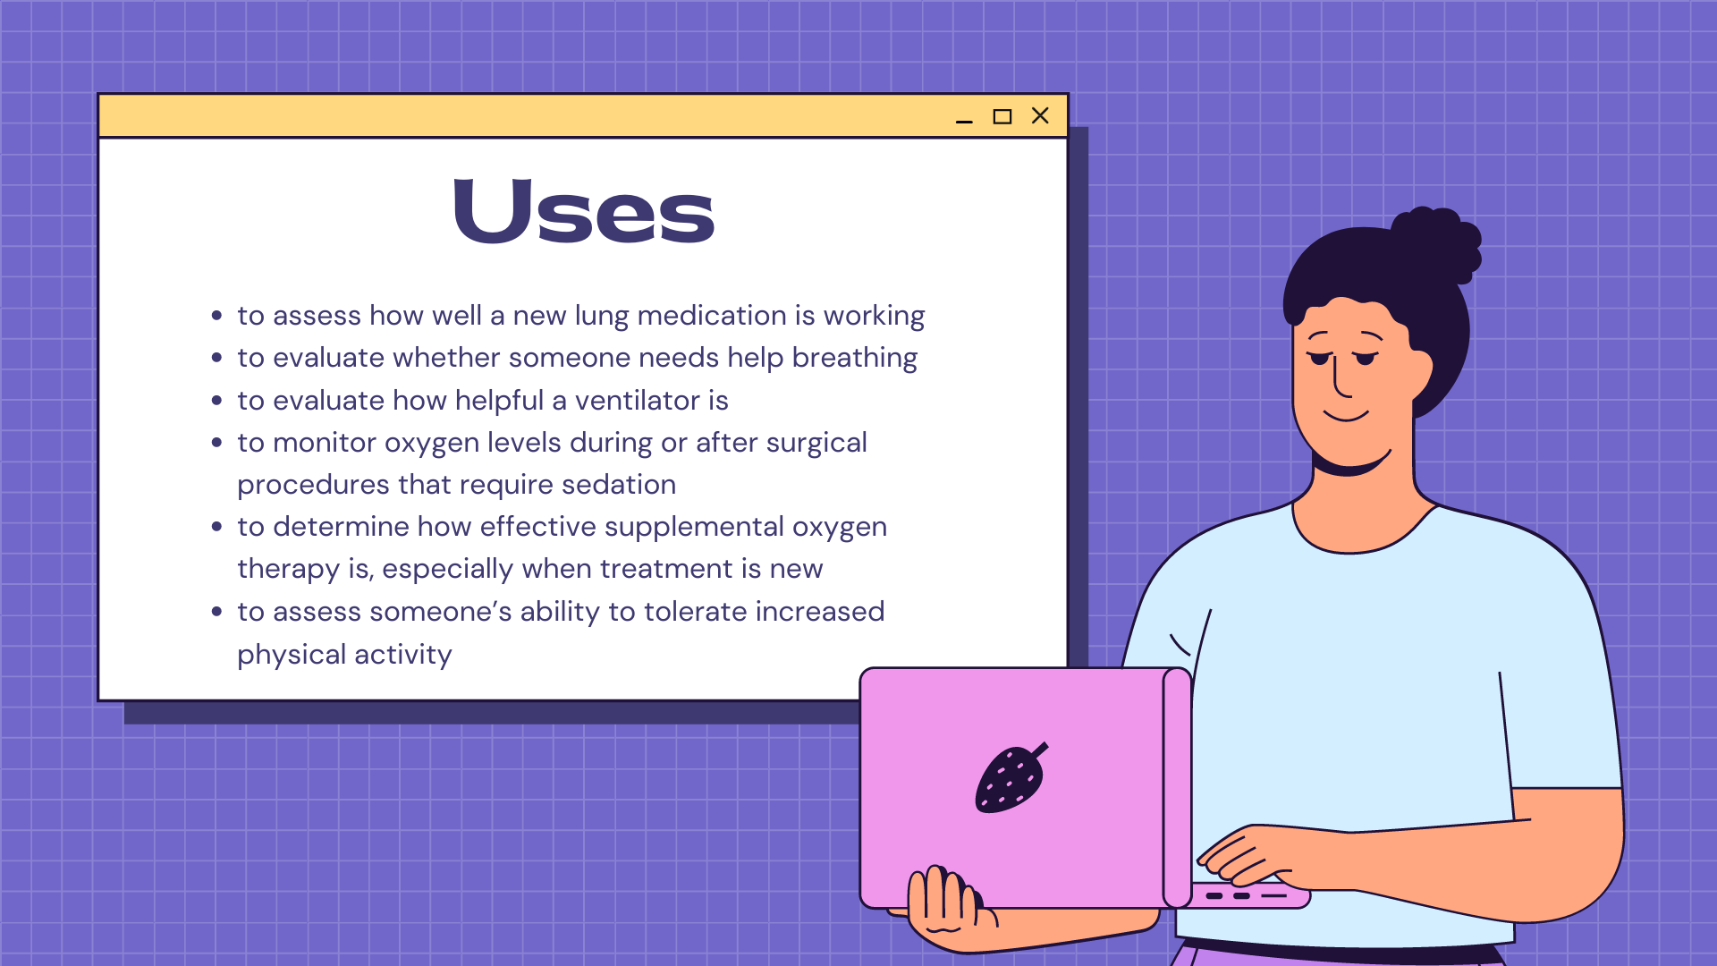

Slide 9


Slide 10


